Slide 1
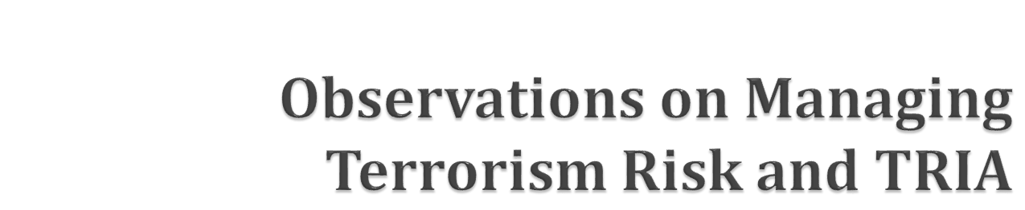
Christopher M. Lewis
September 18, 2013

Slide 2

The Terrorism Risk Insurance Act has worked and should be extended.
Terrorism, by conventional and unconventional means, continues to be a significant threat today (e.g. Syria, Boston).
Insurers have made great strides in improving the management of conventional terrorism losses – largely managing these risks within TRIA’s existing retentions. However, no private insurance mechanism is sufficient for pooling the risk of unconventional or large-scale losses.
TRIA is a balanced public-private partnership – privatizing the management of terrorism risk and the pooling of conventional terrorism losses while maintaining the financing mechanism needed for truly catastrophic terror losses.

Slide 3

The Risk is Not Measurable.
  Willful Act; Dynamic Risk
  No Precedent (e.g., unconventional severity)
  Interrelated and Interdependent: Collective Defense Challenge
  Confidentiality of information
The Risk exhibits Extreme Catastrophe Exposure – correlated across policyholders and with financial markets.
Classic Underwriting/Adverse Selection Problem

Slide 4

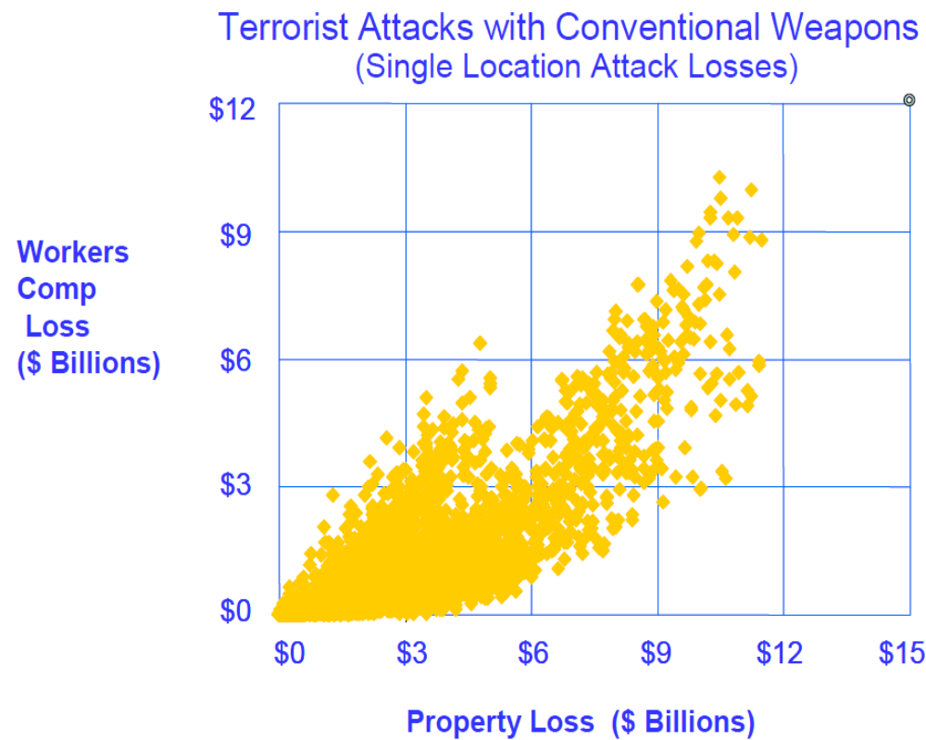
Under existing TRIA retentions, the insurance industry is managing almost all of the risk from single-site, conventional terrorism losses.
A RAND study (2007) estimated that total federal expenditures following a conventional terrorist attack are likely lower with TRIA in place than without TRIA.
  Make available provision increases take-up rates for insurance
  High retentions keep conventional risk in private sector
  Lowers need for post-disaster government assistance
Source: Lewis, Christopher, “Managing the Risk of Terrorism in the Economy: A Public Policy Perspective, American Enterprise Institute Conference “Should TRIA Be Extended, 2005.
Dixon, Lloyd, Robert J. Lempert, Tom LaTourrette and Robert Reville, The Federal Role in Terrorism Insurance: Evaluating Alternatives in an Uncertain World,” RAND Center for Terrorism Risk Management Policy, 2007.

Slide 5




Delivery Method: 2-ton truck bomb 5-ton truck bomb 10-ton truck bomb
Estimated Industry
Losses ($B) ~6.0 ~12.0 ~16.5
Estimated
Fatalities ~1,600 ~4,500 ~7,000
Historical
Events Oklahoma City Beirut Marine Khobai Towers Bombing Barracks Bombing Bombing, Saudi Arabia
Year 1993 1983 2006
Note: estimates based on representative event in NYC central business district; single attack scenario.

Slide 6
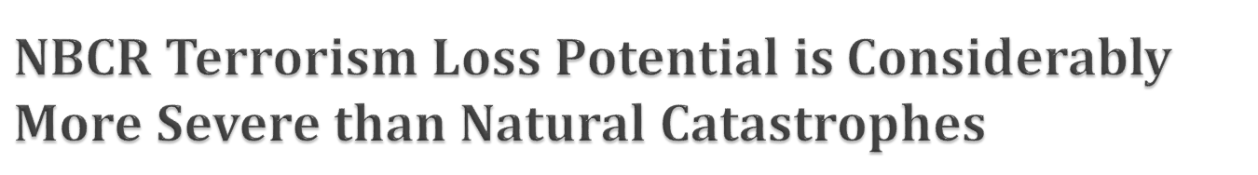
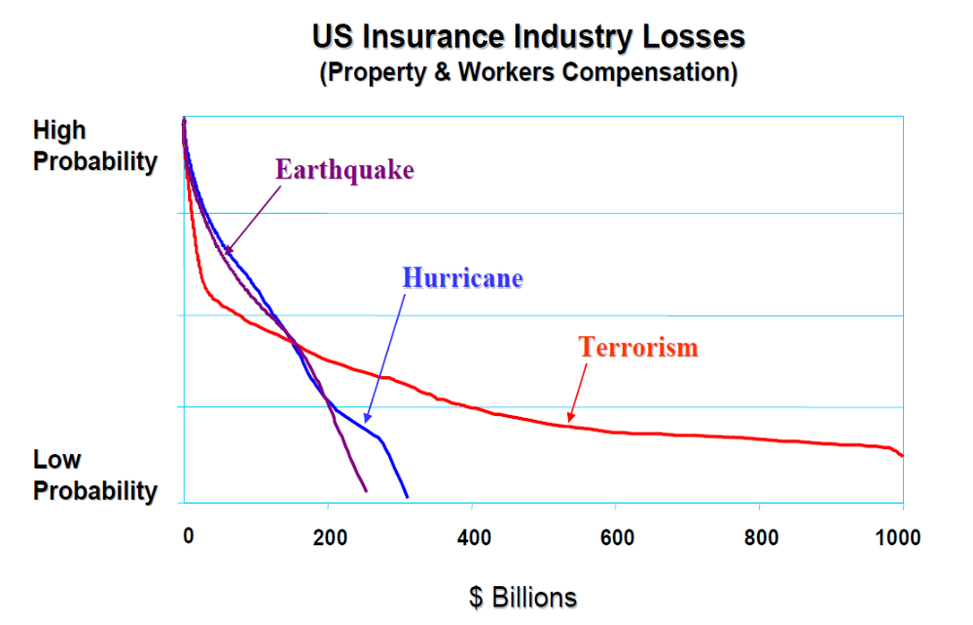
Source: Lewis, Christopher, “Managing the Risk of Terrorism in the Economy: A Public Policy Perspective, American Enterprise Institute Conference “Should TRIA Be Extended, 2005.

Slide 7
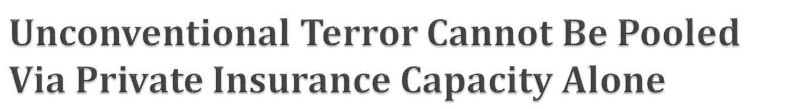
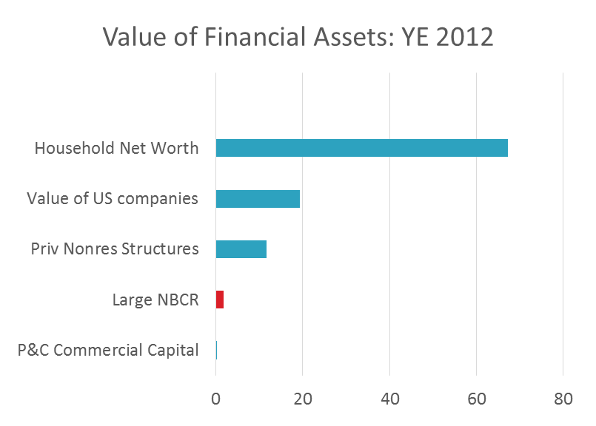
A large-scale, NBCR terrorist attack has the potential to result in almost $750b in insured loss and another $1 trillion in economic loss – a truly catastrophic event.
Based on YE2012 resources, how can the U.S. best pool and finance this risk?
U.S. household net worth was just under $70 trillion
The market value of domestic companies was ~$19 trillion.
Private nonresidential building stock was $12 trillion.
U.S. P&C commercial lines surplus is ~$250b
Source: Federal Reserve Flow of Funds, June 2013.

Slide 8

U.S. Natural Catastrophe
Property Limits
U.S. Terrorism
Property Limits
$150b
Capital Markets Reinsurance Capacity = $30-40b
$100b
TRIA Capacity of $50-$60b+
Traditional Reinsurance Capacity = $90-120b
$50b
$25b
Trad’l Reinsurance = $6-8b
Private reinsurance capacity for terrorism would have to expand by a factor of 4-5 times the current level before raising concerns that TRIA was crowding out private sector capital. Private reinsurance for NBCR is virtually non-existent.
Sources: “Capital Stewardship: Charting the Course to Profitable Growth,” Guy Carpenter Mid-year Market Overview, Marsh & McLellan Companies, September 2013. S&P Global Reinsurance Highlights: 2012. Private terrorism reinsurance capacity from AON testimony, 9/11/12.

Slide 9

With an increasing supply of capital supporting insurance-linked securities (ILS) and new issuance expected to surpass $7.5b in 2013, can non-traditional reinsurance provide capacity?
Unfortunately, not directly…..
  ILS investors generally avoid risks not underwritten in reinsurance markets, prefer risks that are credibly modeled, and often require a rating on the bonds funding the transaction.
  The risk of terrorism is likely correlated with the capital markets – violating the basic investing thesis of the new capital.
  Of the new transactions YTD in 2013, no transactions include terrorism.
Indirectly? Maybe, but only if the competition from the new capital encourages traditional reinsurers to expand their terrorism reinsurance capacity. If so, the impact would be welcome, but marginal relative to TRIA retentions.

